Slide 1
8051 Pin Configuration

Slide 2
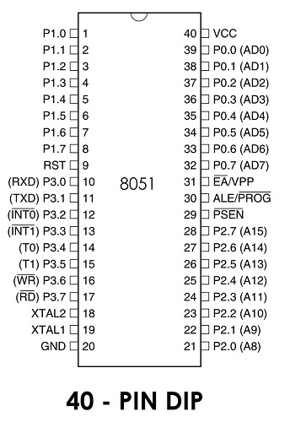
Pin Structure
It has 40-pin DIP (Dual Inline Package) chip.
IO Port Pins
One of the most useful features of the 8051 is that it contains four I/O ports (P0 - P3)
Port 0 （pins 32-39）：P0（P0.0～P0.7）
8-bit R/W - General Purpose I/O Or acts as a multiplexed low byte address and data bus for external memory design
Port 1 （pins 1-8） ：P1（P1.0～P1.7）
  Only 8-bit R/W - General Purpose I/O
Port 2 （pins 21-28）：P2（P2.0～P2.7）
  8-bit R/W - General Purpose I/O Or high byte of the address bus for external memory design
Port 3 （pins 10-17）：P3（P3.0～P3.7）
  General Purpose I/O if not using any of the internal peripherals (timers) or external interrupts.
Each port can be used as input or output (bi-direction)

Slide 3
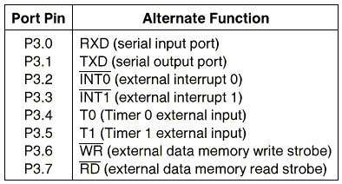

Slide 4
PSEN (out):
Program Store Enable, the read signal for external program memory (active low).
ALE (out):
Address Latch Enable, to latch address outputs at Port0 and Port2
EA (in):
External Access Enable, active low to access external program memory locations 0 to 4K
RXD,TXD: UART pins for serial I/O on Port 3
XTAL1 & XTAL2:
Crystal inputs for internal oscillator.

